Slide 1
Identifying Known Vulnerabilities in OSS libraries
A SURVEY PAPER – Ronaldo canesqui

Slide 2
Agenda
The problem
Vulnerability Lifespan
Current Dependencies Management Practices
Identifying known vulnerabilities and analyzing updatability
Main Challenges
Conclusion

Slide 3
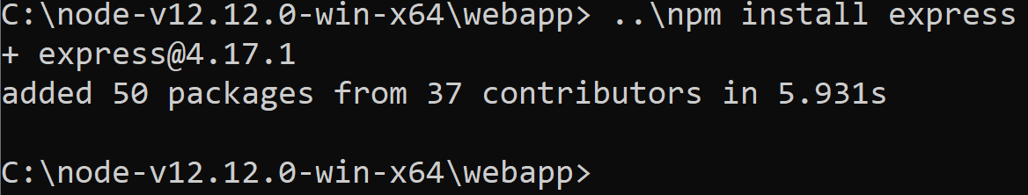
The problem
Notes:
Explain what is nodejs and what is happening here
Highlight the number of packages and contributors for only one direct dependency.
Vulnerabilities?

Slide 4
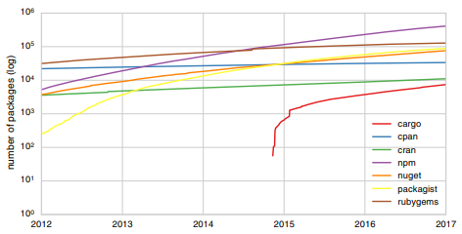
The problem
A. Decan, T. Mens, and E. Constantinou, “On the impact of security vulnerabilities in the npm package dependency network,”
Notes:
Evolution of the number of packages.
An empirical comparison of dependency network evolution in seven software packaging ecosystems
Open npmjs and show the is-odd package and source code

Slide 5
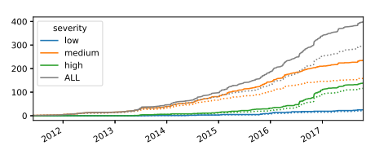
The problem
A. Decan, T. Mens, and E. Constantinou, “On the impact of security vulnerabilities in the npm package dependency network,”
Notes:
Evolution of the number of discovered vulnerabilities (straight lines) and corresponding distinct packages (doted lines) per severity
On the Impact of Security Vulnerabilities in the npm Package Dependency Network

Slide 6
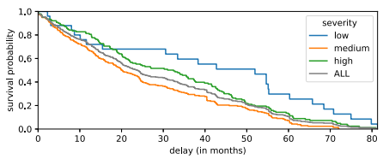
Vulnerability Lifespan
How long does the package remain vulnerable
A. Decan, T. Mens, and E. Constantinou, “On the impact of security vulnerabilities in the npm package dependency network,”
Notes:
700 security vulnerability report
Retrived the corresponding releases
Relationship between package, vulnerability, first release date and vulnerability discovery date they traced the vulnerability time frame
Survival probability for event “vulnerability is fixed” w.r.t. the date of first affected release.
After 10 months, there is a probability higher than 80% that a high severity vulnerability is still not ﬁxed.

Slide 7
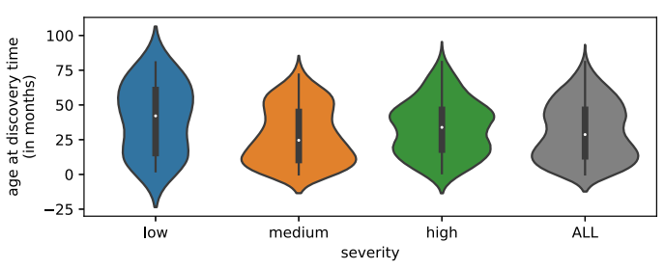
Vulnerability Lifespan
When a vulnerability is discovered
A. Decan, T. Mens, and E. Constantinou, “On the impact of security vulnerabilities in the npm package dependency network,”
Notes:
700 security vulnerability report
Violin plots of packages age at discovery time by vulnerability severity.
Most severities are found in packages older than 28 months.
On the Impact of Security Vulnerabilities in the npm Package Dependency Network

Slide 8
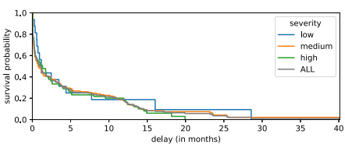
Vulnerability Lifespan
When a vulnerability is ﬁxed
A. Decan, T. Mens, and E. Constantinou, “On the impact of security vulnerabilities in the npm package dependency network,”
Notes:
700 security vulnerability report
Survival probability for event "vulnerability is fixes" w.r.t. vulnerability discovery time.
On the Impact of Security Vulnerabilities in the npm Package Dependency Network

Slide 9
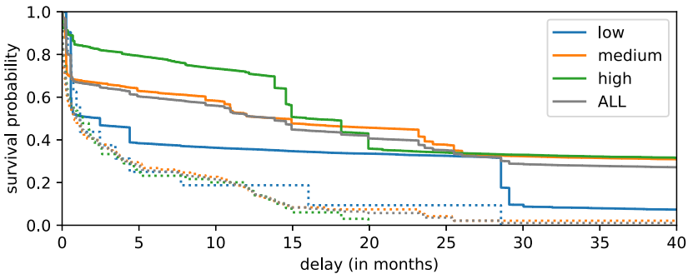
Vulnerability Lifespan
When a vulnerability is ﬁxed in a dependent package
A. Decan, T. Mens, and E. Constantinou, “On the impact of security vulnerabilities in the npm package dependency network,”
Notes:
700 security vulnerability report
Survival probability for event “package is fixed” w.r.t. vulnerability discovery time. Dependent packages are
shown as straight lines and upstream packages as dotted lines.
On the Impact of Security Vulnerabilities in the npm Package Dependency Network

Slide 10
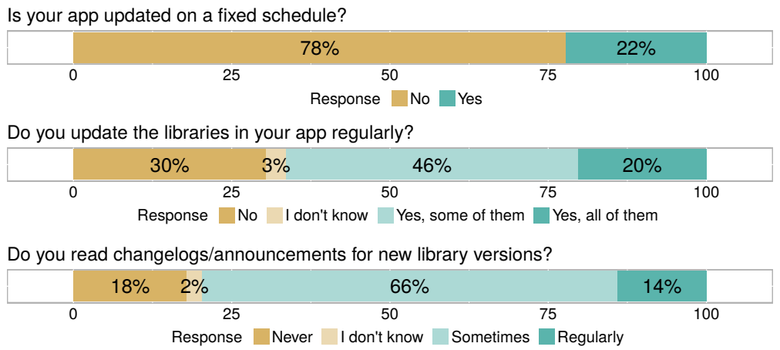
Dependencies Management
Anwsers for questions regarding app/library release frequency
E. Derr, S. Bugiel, S. Fahl, Y. Acar, and M. Backes, “Keep me updated: An empirical
study of third-party library updatability on android
Notes:
Anwsers for questions regarding app/library release frequency.

Slide 11
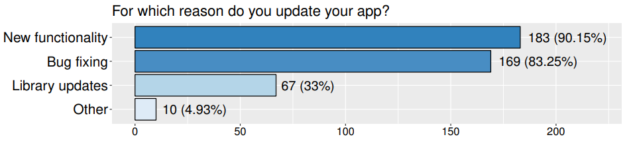
Current Dependencies Management Practices
Reasons to update your app
E. Derr, S. Bugiel, S. Fahl, Y. Acar, and M. Backes, “Keep me updated: An empirical
study of third-party library updatability on android
Notes:
203 Google play application maintainers

Slide 12
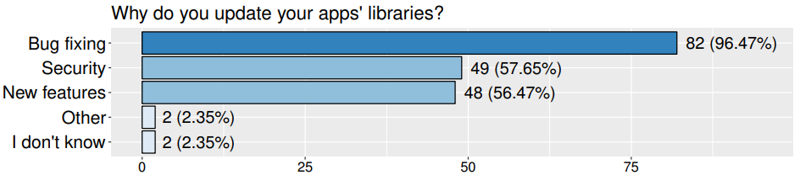
Current Dependencies Management Practices
Reasons to update app
E. Derr, S. Bugiel, S. Fahl, Y. Acar, and M. Backes, “Keep me updated: An empirical
study of third-party library updatability on android

Slide 13
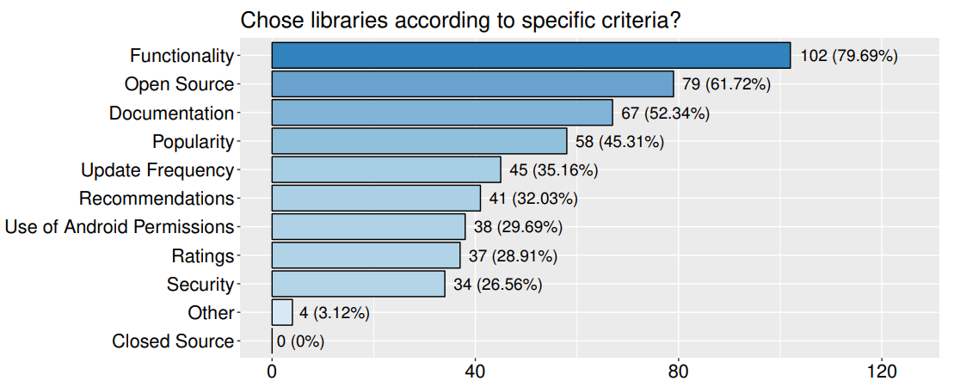
Current Dependencies Management Practices
Selection Criteria
E. Derr, S. Bugiel, S. Fahl, Y. Acar, and M. Backes, “Keep me updated: An empirical
study of third-party library updatability on android

Slide 14
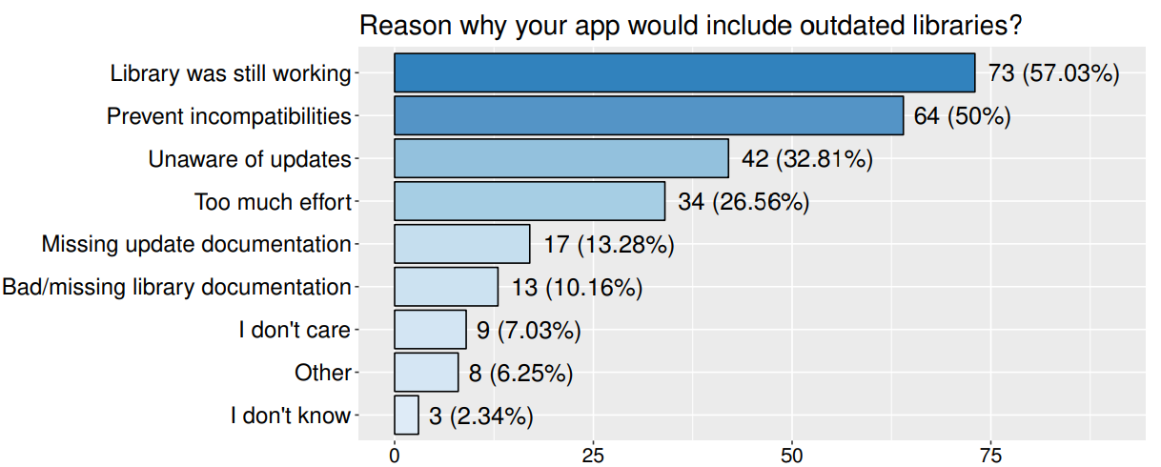
Current Dependencies Management Practices
Why include outdated libraries
E. Derr, S. Bugiel, S. Fahl, Y. Acar, and M. Backes, “Keep me updated: An empirical
study of third-party library updatability on android

Slide 15
Identifying known vulnerabilities
Predicting Vulnerabilities
VCCFinder
CVE database
Vulnerabilities commit
Used metadata information
SVM-based model
Reduce 99% number of false positives compared to Flawfinder
Identified 53 out of 219 know vulnerabilities
H. Perl, S. Dechand, M. Smith, D. Arp, F. Yamaguchi, K. Rieck, S. Fahl, and Y. Acar,
“Vccﬁnder: Finding potential vulnerabilities in open-source projects to assist code audits”
Notes:
Solutions on identifying vulnerabilities, not a comprehensive list

Slide 16
Identifying known vulnerabilities
Measuring dependency freshness
Extract metadata from pom.xml files
Compared with Maven Central Repository to obtain newer releases
Proposes metrics to warn about vulnerabilities
Able to correlate the metrics with vulnerabilities
Only considers direct dependencies
J. Cox, E. Bouwers, M. van Eekelen, and J. Visser, “Measuring dependency freshness in software systems”
Notes:
Solutions on identifying vulnerabilities, not a comprehensive list

Slide 17
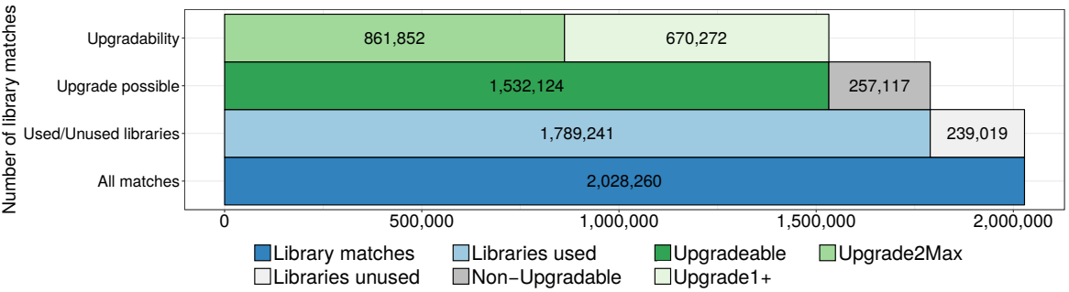
Identifying known vulnerabilities
Library updatability
Analyzed usage of 98 libraries against 1,246,118 apps from Google play
Compare the current library methods to newer libraries to determine the updatability
E. Derr, S. Bugiel, S. Fahl, Y. Acar, and M. Backes, “Keep me updated: An empirical
study of third-party library updatability on android
Notes:
Solutions on identifying vulnerabilities, not a comprehensive list

Slide 18
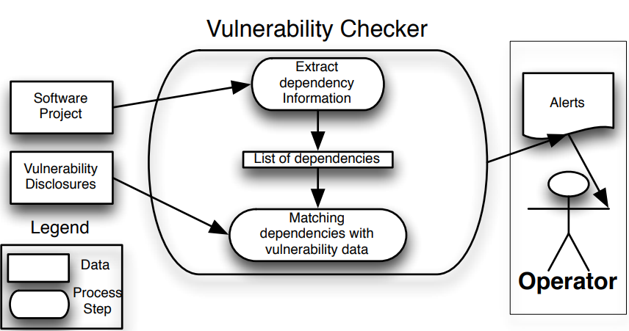
Identifying known vulnerabilities
Vulnerability Alert Service - VAS
Uses CVE entries and Maven dependencies to identify vulnerabilities
Only direct dependencies
M. Cadariu, E. Bouwers, J. Visser, and A. van Deursen, “Tracking known security vulnerabilities in proprietary software systems”
Notes:
Solutions on identifying vulnerabilities, not a comprehensive list

Slide 19
Identifying known vulnerabilities
Code-based vulnerability identification
Uses a manual built database which relates vulnerability information, affected package, and commits introducing and fixing the vulnerability
Extract list of dependencies from pom.xml files
Remove not deployed dependencies (tests)
Matches vulnerabilities with source code using dynamic and static analysis
Authors claim this is the state-of-art
Use by SAP on 500+ development projects
S. E. Ponta, H. Plate, and A. Sabetta,
“Beyond metadata: Code-centric and usage-based analysis of known vulnerabilities in open-source software”
Notes:
Solutions on identifying vulnerabilities, not a comprehensive list

Slide 20
Main Challenges
Common challenges on all works related to identifying know vulnerabilities
Challenges only mentioned explicitly by one paper
Non-uniform reporting of products affected by a vulnerability - In some cases, only the CPE of the respective library is mentioned, in other cases, products or libraries using the library are also listed.
Vulnerability and dependency management make use of different naming schemes and nomenclatures - CPE does not straight map to packages repositories such as Maven or npm.
Vulnerabilities and VCS information of the respective patch are not linked in a systematic and machine readable fashion - While committing a ﬁx to the repository, developers do not have a standard way to refer to the CPE.

Slide 21
Conclusion
Not a single solution that fit majority of cases
Simpler approaches may be enough depending on the case
All works compiled in the paper depend on a manual step that in its absence the work would be infeasible
Improved know vulnerabilities databases and standard ways to identify the OSS libraries in the repositories and commits would increase signiﬁcantly the automation level and the impact of the available solutions.

